Slide 1
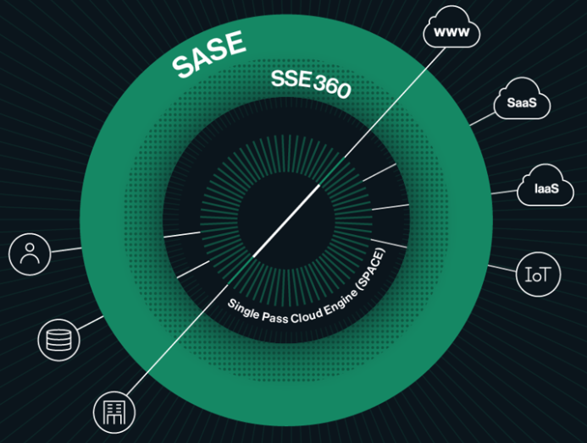
Data Security
Use Cases

Slide 2





Data Security
Accessing SaaS and/or On-prem Applications – Business Drivers
Finance
Retail
Insurance
Legal
Manufacturing
Digital Banking
Automated Compliance Monitoring and Detection
Fraud Detection
E-commerce (online storefronts)
POS
Inventory and Supply chain management
Policy Admin Systems
Self-service portals
Claims Automation
Compliance and Risk Management
Case Management
Contract Lifecyle management
ERP
Supply Chain Integration
Predicative Maintenance

Slide 3
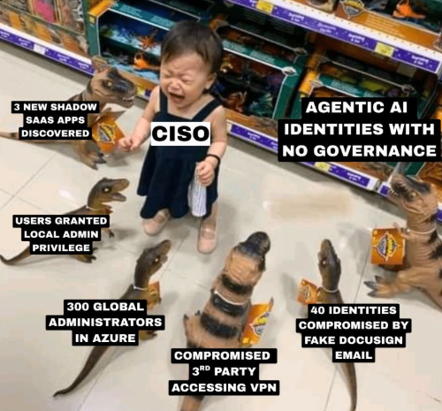
Data Security
Accessing SaaS and/or On-prem Applications – Challenges

Slide 4

Data Security – Use Cases
Data Loss Prevention
Cloud Discovery
& Control
Compliance &
Governance
Detect and Prevent the sharing of sensitive data e.g., PII, PHI
Discover and control access to all sanctioned and unsanctioned cloud/AI apps (Shadow IT & AI)
Assess cloud application security posture against compliance frameworks e.g., ISO 27001, SOX, PCI-DSS

Slide 5
Data Security Use Cases & Solutions
Accessing SaaS and/or On-prem Applications - Solutions
No | Use Case | Challenge | Cato Networks Solution
1 | Discover all cloud applications and services in the organisation | Shadow IT introducing unknown and unmanaged risks within the environment | CASB licence. Application Control Rulebase in Monitor mode.
2 | Inline and Out of Band SaaS Application controls | Enables users to safely access and use sanctioned and shadow cloud applications and lets you enforce a corporate policy. | CASB licence. Sanctioned Apps Category and Application Control Policy. For Out of band use the integrations with SaaS applications.
3 | Assess the risks and compliance posture of the cloud apps | Ensuring that the organisation meets internal security policies and relevant industry or compliance requirements. | CASB licence. Cloud Apps Dashboard and Application Analytics.
4 | Data exfiltration from the corporate apps | Confidential corporate data represents one of the most valuable assets within any organisation. Robust safeguards is required to ensure this information remains secure and cannot be exfiltrated or misused. | CASB and DLP licenses. Configuring Data Control rules as part of the Application Control policy
5 | Visibility into corporate data stored in the cloud | Getting a clear understanding on where corporate data is stored across various cloud applications. | CASB licence. Sanctioned Apps Category and Application Control Policy. For Out of band use the integrations with SaaS applications.
6 | Threat Protection for Cloud Threats | Malware or ransomware related attack threats to data stored in the cloud | IPS license. IPS protection policies. Custom apps category for high-risk apps and policy enforcement using the internet firewall
7
8
9
10
11
12

Slide 6
Additional Resources

